Slide 1
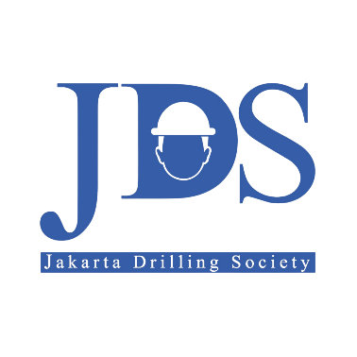
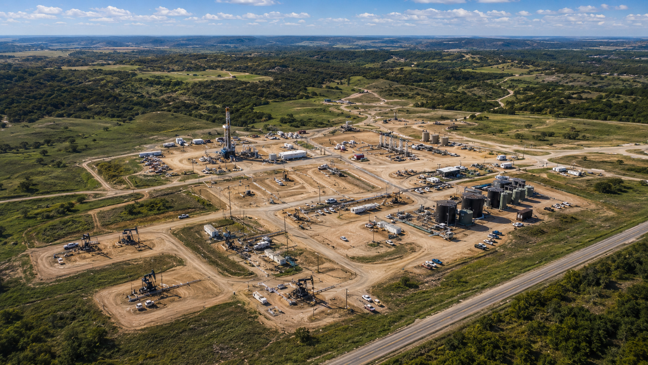

JDS 2026 DRILLING CAMPAIGN
SW (Single Well) DPM (Drilling Project Management) BOD: ALPHA-07
CORE ENERGY SOLUTION
GROUP 6 ONLINE

Slide 2
MEET THE TEAM
Total Members
Drilling Eng.
Subsurface
Facilities / HSE
Project Integration
10
5
2
2
1
Alpha-07 BOD Preparation Team
Responsibility Coverage
No.
Name
Discipline / Responsibility
Drilling Engineering
5
Subsurface
2
1
Abrar Laylramadhan
Drilling Engineering
• Well design basis
• Trajectory / BHA
• Drilling execution
• Targets & geology
• PPFG / fluids
• Reservoir basis
2
Bernard Cavin Ronlei Sihombing
Drilling Engineering
3
Adriansyah Andra Kusuma
Drilling Engineering
4
Nyoman Prema Ananda
Drilling Engineering
Facilities / HSE
2
Project Integration
1
5
Salman Arkan
Drilling Engineering
• Wellsite readiness
• Surface facilities
• HSSE interface
• BOD coordination
• Cross-discipline alignment
• Document control
6
Asri Permatasari Sirait
Subsurface
7
Abdi Surya
Subsurface
8
Hana Malem Karina Panjaitan
Facilities
9
Shanaz Ivona Dewi Limaran
Facilities / HSE
10
Muhammad Hammam Reza
Project Integration

Slide 3
OUTLINE
01
Ch. 1–2
02
Ch. 3 + 6
03
Ch. 4 + 9
Well Overview & Project Basis
Subsurface & Geomechanics Basis
Well Trajectory, Directional Drilling & BHA
General well information, project background, objectives, success criteria, constraints, assumptions, and well schematic.
Reservoir targets, offset data, PPFG, subsurface hazards, stress model, wellbore stability and mud-weight window.
J-type profile, KOP/BUR/DLS, torque & drag, BHA configuration, bit selection, MWD and directional-control plan.
04
Ch. 5 + 8
05
Ch. 7
06
Ch. 10 + 14
Casing, Tubing & Cementing Design
Drilling Fluids & Hydraulics
Well Control, Pressure Control & Rig Capability
Casing seat, kick tolerance, structural load, material/connection selection, cement slurry and zonal isolation.
KCl-Polymer WBM, mud weight, rheology, ECD/SPP limits, hole cleaning, flow-rate requirement and bit hydraulics.
Well barrier philosophy, pressure rating, BOP/choke manifold, wellhead, rig hoisting, mud pump and power capability.
07
Ch. 11 + 12
08
Ch. 13 + 15
09
Ch. 16 + 17 + 18
Completion, Production & Well Abandonment
Wellsite & Execution Strategy
Risk, Schedule, Cost & Project Assurance
Cased-hole ESP completion, production tubing/accessories, completion testing, suspension and abandonment philosophy.
Wellpad, cellar/conductor, access road, water, waste management, logistics readiness and operational sequence.
Risk register, mitigation, detailed timeline, cost, document control, references, review and approval workflow.

Slide 4
WELL OVERVIEW & PROJECT BASIS

Slide 5
WELL OVERVIEW & PROJECT BASIS
Project Background & Development Justification
Well Identification, Location & Administrative Data
Field maturity: Alpha Field OOIP is 21.66 MMSTB against ~6.48 MMSTB cumulative production — a recovery factor of only 16.62% at ~99% water cut.
Development concept: Alpha-07 is the anchor well of a phased five-well infill programme delivering ~0.58 MMBO incremental recovery to the 2041 economic limit.
Production basis: commingled oil from the Bara, Bama, Raja and Prima sands; IP 132 BOPD (P10–P90 106–158) and EUR 156 MBO.
Capital efficiency: existing Core Energy Solution facilities are used, no major new infrastructure is required and the wellpad is held to 2–2.5 ha.
Well name: Alpha-07 — legal well name Alpha 07, assigned on PTD approval.
Operator / area: Core Energy Solution, WK Core Energy Solution; regulator SKK Migas.
Classification: development well — directional producer, infill and step-out.
Trajectory category: Directional Oil Well (DOW), J-type; well 1 of 5 in the programme.
Field / basin: Alpha Field, Central Sumatra Basin — onshore, approximately 2 × 2 km².
Coordinates: surface 748,934.38 [TBC] / 110,089.99; target 749,434.38 / 109,589.99.
Wellpad: new pad on a clustering concept, 2–2.5 ha footprint; terrain generally flat.
Land & permits: LI / LER land process; AMDAL / UKL-UPL; drilling waste routed to CMTF.
Status: Gate-1 sanctioned; Phase 2 Basis of Design in preparation.
OOIP
21.66 MMSTB
Cumulative Oil
6.48 MMSTB
Recovery Factor
16.62%
Water Cut
~99%
Key Design Parameters — Alpha-07 BOD Rev. 0 (Table 1.4)
Planned TD
5,312 ft MD
TVD at TD
4,664 ft TVD
Hole Sections
12-1/4" / 8-1/2"
Casing Programme
9-5/8" & 7" K-55
Trajectory
J-type 30.41°/135°
Surface Csg Point
1,821 ft MD
Drilling Fluid
KCl-Polymer WBM
Completion String
3-1/2" EUE + ESP
Rig Class
750 HP land rig
Well Control
13-5/8" 5M BOP
Well Cycle Time
21.3–29.3 days
Total AFE
USD 1.96 M
Well Objective, Target Reservoirs & Surface Constraint (Table 2.4)
Objective: commingled oil production from four stacked sandstone reservoirs — Bara (4,042–4,238 ft TVD), Bama (4,238–4,367), Raja (4,367–4,527) and Prima (4,527–4,676 ft TVD).
Completion targets: six sand markers carry movable hydrocarbon — T_Bara1, T_Bama2 (oil and gas), T_Raja1, T_Raja3, T_Raja5 and T_Prima1. TD is set near top of argillite basement.
Surface constraint: population, oil palm, HTI and protected forest overlie the targets, so the J-type profile carries 2,437 ft of displacement to keep the pad clear of them.

Slide 6
DESIGN DRIVERS, SUCCESS CRITERIA & PROJECT CONSTRAINTS
Key Technical Design Drivers (Table 1.2)
Scope and Authority of This Basis of Design
1 · Depleted reservoir beneath normally pressured shale — shale pore pressure ~8.66 ppg against reservoir pressure ~6.21 ppg (RFT) and minimum sand FG ~10.75 ppg. Narrow operating MW window; losses and differential sticking governed by one MW-versus-depth policy (Ch. 3, 6, 7).
2 · Chronic instability in the Arya and Buana shales — tight hole in 5 of 6 offsets and sloughing in 3 of 6; MW raised to 10.0–10.3 ppg on Alpha-03 and Alpha-05. Proactive MW profile, minimum 5% KCl inhibition, conditioning and wiper trips before logging and casing (Ch. 6, 7).
3 · J-type profile with large surface-to-target offset — 2,437 ft horizontal displacement at 30.41° inclination, forced by surface land constraints. Top drive mandatory; torque and drag envelope, DLS limits and directional hole-cleaning and ECD criteria (Ch. 4, 7).
4 · Casing running and logging tool access risk — three offsets required a casing swage, Alpha-05 set its shoe 11 ft short of TD and logging tools stopped in 3 of 6 wells. Hole conditioning acceptance criteria plus contingency logging and a standard swage (Ch. 9, 11).
5 · Long lead item and completion criticality — ESP is custom manufactured on a 16–24 week lead time; 140 jts of 7" casing, 48 jts of 9-5/8" and 161 jts of tubing. Casing, tubing and completion design frozen at BOD approval (Ch. 5, 11).
In scope: design criteria and acceptance limits for subsurface and PPFG, geomechanics, trajectory, casing and cementing, fluids and hydraulics, BHA and directional, well control, completion, rig and site, risk, schedule and cost.
Out of scope: step-by-step operating procedures (DDP), commercial terms of rig and service contracts, surface facilities downstream of the wellhead, reservoir management beyond interval selection.
Change control: any deviation from the criteria stated here is a formal design change requiring re-endorsement by the Drilling Review Board.
Well Success Criteria (Table 1.5)
Technical — penetrate all four target reservoirs and reach TD 5,312 ft MD with the production casing landed at the design shoe depth.
Subsurface data — acquire a complete evaluation dataset: triple combo, pressure test and sidewall core over the full interval.
Production — confirm the DCA forecast against the Alpha-01, Alpha-02 and Alpha-05 analogues: IP 132 BOPD, EUR 156 MBO.
Cost & schedule — cost overrun no more than 10% of AFE, NPT below 5–10%, well cycle time 21.3–29.3 days.
HSSE — zero LTI, zero fatality, zero major incident and zero reportable spill.
Design Assumptions, Project Constraints and Open Items to Close Before Gate 2 (Table 1.6)
Assumptions
PPFG is calibrated on offset data over ten years old with limited sonic, LOT/FIT and pressure points — the largest single technical uncertainty.
Depletion is assumed to have continued since the last survey; actual reservoir pressure may be lower.
No shallow gas, negligible H₂S and acceptable CO₂ — this assumption governs the 5M well control specification.
Existing surface facilities can accept up to 2,000 BFPD without modification.
Constraints
Surface land use — population, oil palm, HTI and protected forest — limits the wellpad to 2–2.5 ha.
Sanctioned envelope USD 1,779,610 plus 10% contingency; target spud 1 November 2026.
ESP lead time 16–24 weeks; casing, tubing and completion design frozen at BOD approval.
Risk baseline of 29 items — 7 high, 17 medium, 5 low, none rated extreme.

Slide 7
SUBSURFACE & GEOMECHANICS BASIS

Slide 8
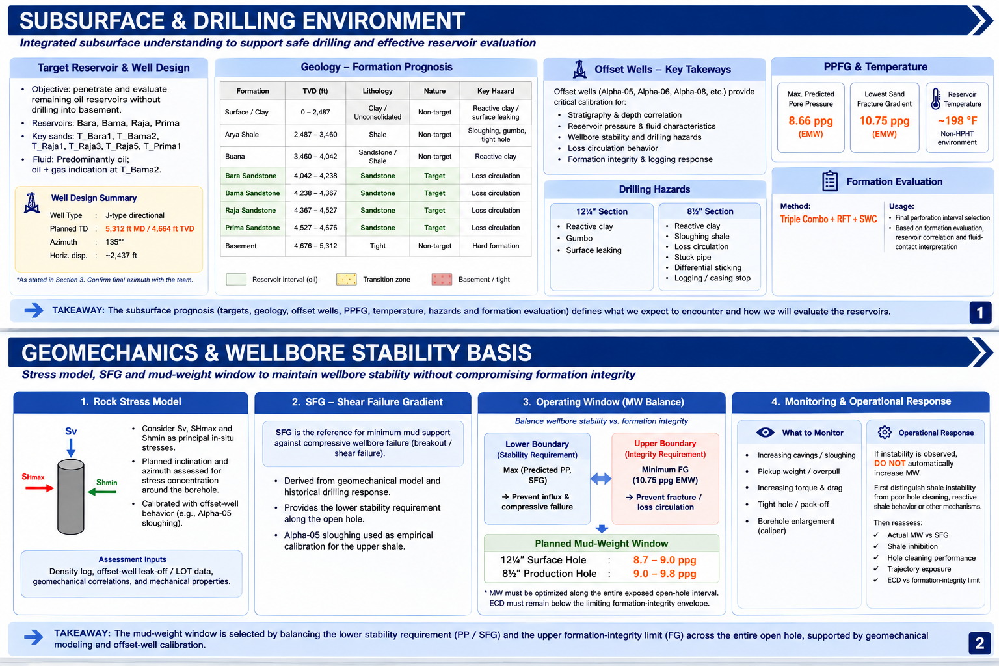
SUBSURFACE & GEOMECHANICS BASIS
Subsurface & Drilling Environment
Integrated Subsurface Understanding to Support Safe Drilling & Effective Reservoir Evaluation
Geomechanics & Wellbore Stability Basis
Stress Model, SFG, and Mud-Weight Window to Maintain Wellbore Stability without Compromising Formation Integrity

Slide 9
WELL TRAJECTORY, DIRECTIONAL DRILLING & BHA

Slide 10
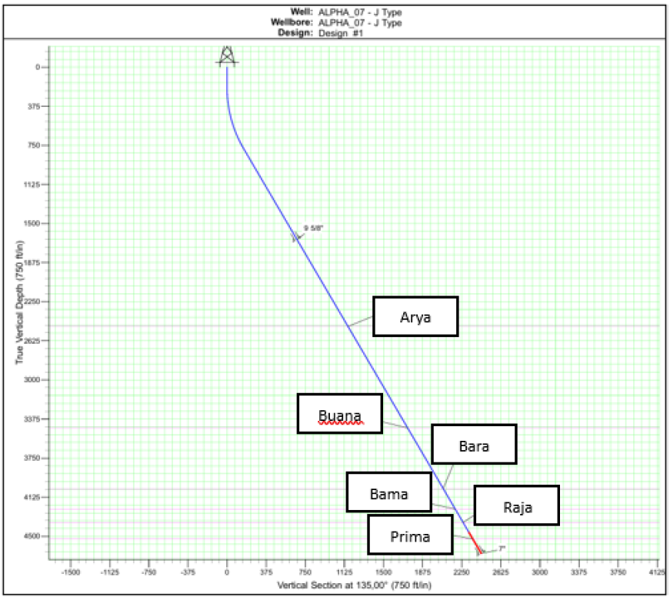
WELL TRAJECTORY & DIRECTIONAL DRILLING BASIS
Proposed J-Type Trajectory
Key Trajectory Design Parameters
Well Profile
J-Type
Directional
KOP
200 ft MD
BUR
5°/100 ft
EOB
808.2 ft MD
Hold Inclination
30.41°
Azimuth
135°
Horz. Displacement
2,437 ft
Planned TD
~5,312 ft MD
Directional Drilling Operating Philosophy
Survey / Correction Limits
Build Section: Controlled steering from KOP until 30.41° tangent is achieved.
Tangent Section: Minimize inclination/azimuth corrections to reduce tortuosity and local doglegs.
Target Assurance: Keep well inside approved trajectory and 75-ft target radius.
Survey Policy: 1 survey/stand in build; ~300 ft (≈5 stands) in stable tangent.
Directional System: Mud motor + MWD; NMDC required for magnetic isolation.
Max Tangent Correction: ~2° only when required.
Max Individual Slide per Correction: ~15 ft.
Acquire survey before planned connection; after connection rotate to break gel.
Torque & Drag / Running Envelope
12-1/4" Hole
Max P/U Hookload
101.6 kip
12-1/4" Hole
Max surface torque
7,228.7 ft·lbf
9-5/8" Casing Run
Max P/U Hookload
106.3 kip
Design Intent: Smooth vertical–build–tangent profile to reach Bara, Bama, Raja and Prima targets while reducing land constraints and keeping logging/casing/completion operations practicable.
8-1/2" Hole
Max P/U hookload
162.8 kip
8-1/2" Hole
Max surface torque
10,515.2 ft·lbf
7" Casing Run
Max P/U Hookload
178.8 kip

Slide 11
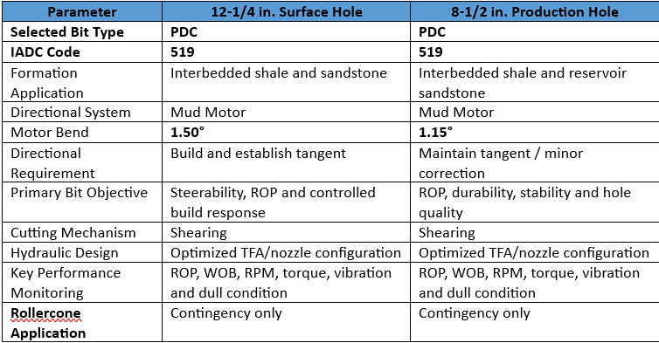
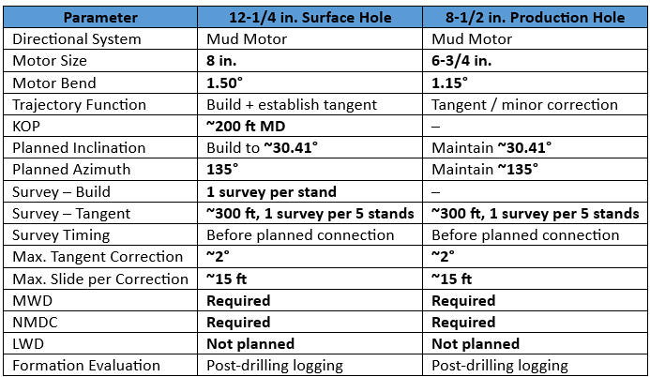
BHA CONFIGURATION, BIT SELECTION & MWD PLAN
12-1/4" Surface Hole – Build + Establish Tangent
8-1/2" Production Hole Tangent / Minor Correction
Bit Selection Criteria
BHA Stack
Design Intent
BHA Stack
Design Intent
12-1/4" PDC Bit | IADC 519
Directional BHA for build section from KOP (~200 ft MD) to 9-5/8 in. casing point (~1,821 ft MD).
1.5° bend selected to deliver higher directional response and controlled build rate.
MWD + NMDC ensure survey accuracy; jar included as sticking contingency.
Key objective: reach ~30.41° inclination and 135° azimuth, then enter smooth tangent.
8-1/2" PDC Bit | IADC 519
Directional BHA for production section to TD (~5,312 ft MD) with focus on smooth tangent maintenance.
1.15° bend gives enough steering for minor corrections while reducing DLS/tortuosity.
Configuration supports lower torque & drag and easier logging and 7 in. casing running.
Jar remains part of the BHA as precaution against downhole sticking.
8" Mud Motor | 1.5° bend
6-3/4" Mud Motor | 1.15° bend
8" Float Sub c/w Float
6-3/4" Float Sub c/w Float
11" Integral Blade Stabilizer
7-7/8" Integral Blade Stabilizer
8" NMDC
6-3/4" NMDC
8" MWD
6-3/4" MWD
8" Pony NMDC + X/O Sub
6-3/4" Pony NMDC
Directional Drilling / MWD / LWD Requirements
8×5" HWDP
10×5" HWDP
Bit Type
PDC 519
Bit Type
PDC 519
6-1/2" Drilling Hydraulic Jar
6-1/2" Drilling Hydraulic Jar
10×5" HWDP
Motor
8" | 1.50°
~33×5" HWDP
Motor
6-3/4" | 1.15°
5" Drill Pipe
5" Drill Pipe
Survey
1/stand (build)
Survey
~300 ft / 5 stands
Primary Objective
Steerability
+ ROP
Primary Objective
Durability
+ ROP + hole quality

Slide 12
CASING, TUBING & CEMENTING DESIGN

Slide 13
CASING SEAT SELECTION & KICK TOLERANCE
Casing Seat Selection Basis
Kick Tolerance Verification
Surface Csg Hole
12-1/4 in.
Setting Depth
1,821 ftMD
Production Csg Hole
8-1/2 in.
Setting Depth
5,312 ftMD
Critical Shoe
9-5/8 in.
Max MW
9.8 ppg
LOT / FIT
14.4 ppg
Calculated KT
33.8 bbl
Surface Casing Seat: landed inside competent shale, preferred geological window ≈1,550–1,650 ftTVDSS, to give a reliable shoe and adequate formation integrity for drilling the 8-1/2 in. section.
Production Casing Seat: set at 5,312 ftMD / 4,664 ftTVD full coverage of Bara, Bama, Raja & Prima plus sufficient rat hole below the deepest objective.
MW Window: 8.7–9.0 ppg (surface) and 9.0–9.8 ppg (production), verified against PP, SFG and the minimum FG in open hole.
Why the 9-5/8 in. shoe? It is the pressure-containment limit while drilling the subsequent 8-1/2 in. hole, so kick tolerance is assessed there.
Requirement: minimum 10 bbl (≈1.5 m³) across a kick-intensity design range of 0–0.5 ppg.
Result: 33.8 bbl at 0 ppg KI allowable kick volume stays above the 10-bbl minimum over the whole 0–0.5 ppg range, so the planned surface casing depth is adequate.
Structural Load Case Design
Minimum Material & Connection Specification
Design Mode | Min. DF | Governing Load Cases
Burst | 1.10 | Gas kick profile, pressure test, tubing leak
Collapse | 1.10 | Cementing, partial evacuation
Axial | 1.25 | Running in hole, self-weight, margin overpull
Triaxial | 1.25 | Combined pressure + axial loading
Tubular | OD / Weight | Grade | Conn. | Selection Basis
Surface Casing | 9-5/8 in. / 36 ppf | K55 | BTC | Axial capacity for running + drilling loads
Production Casing | 7 in. / 23 ppf | K55 | BTC | Burst, collapse, axial & triaxial capacity
Production Tubing | 3-1/2 in. / 9.3 ppf | J55 | EUE | ESP string, tensile & make-up reliability
Casing | Burst | Collapse | Axial | Triaxial | Status
9-5/8 in., 36 ppf, K55 | 3.52 | 2.88 | 1.91 | 1.90 | PASS
7 in., 23 ppf, K55 | 2.18 | 1.47 | 1.42 | 1.41 | PASS
Why BTC? Buttress thread gives higher axial capacity than round thread; the moderate 30.41° J-type inclination does not require a premium gas-tight connection under the current basis.
Why no special metallurgy? No significant H₂S/CO₂ expected and no historical corrosion in offset wells — API grades are retained.
All calculated SFs exceed the minimum design factors — preliminary K55 selection is supported, to be revalidated with final trajectory, PPFG and completion load cases.

Slide 14
CEMENTING OBJECTIVES, SLURRY & ZONAL ISOLATION
Cementing Objectives & Zonal Isolation Requirement (Table 8.1)
Cement System – Both Strings
Class G, Dual Slurry
Lead / Tail Density
12.5 / 15.8 ppg
TOC – 9-5/8 in. Surface Casing
≥200 ft above shoe
TOC – 7 in. Production Casing
≥500 ft above Bara sand
Surface Casing Objective: isolate shallow formations, protect groundwater zones, support the wellhead and establish a competent shoe for drilling the production section.
Production Casing Objective: hydraulic isolation across Bara Prima, prevent gas migration, and provide a competent sheath for selective perforation and the ESP completion.
Key Risk – Offset Experience: several Alpha Field wells recorded incomplete or absent cement return; others needed large excess volumes to reach surface.
Design Response: coverage is secured through excess-volume design, hole-volume verification and displacement optimisation not theoretical gauge-hole volume alone.
Cement Slurry Property Limits (Table 8.2)
Placement Strategy & Displacement Efficiency
Property | 12-1/4" Lead | 12-1/4" Tail | 8-1/2" Lead | 8-1/2" Tail
Density, ppg | ≥12.5 | 15.8 | ≥12.5 | 15.8
Excess over theo. | 150% | 150% | 200% | 40%
Thick. Time (70BC) | <4 hrs | <4 hrs | <6 hrs | <4 hrs
Comp. Strength | 600 psi ≤17h | 1500 psi ≤7h | 600 psi ≤20h | 1000 psi ≤8h
24-hr Crush, psi | ≥600 | ≥1,750 | ≥600 | ≥2,000
Fluid Loss, cc | <300 | <100 | <150 | <100
BHCT / BHST | 122 °F | 122 °F | 198 °F | 198 °F
Hole Conditioning
≥2 Hole Vol.
Spacer / Scavenger
11.0 ppg
Min. Standoff
67%
Bump Plug
+500 psi
Mud Removal: circulate ≈2 hole volumes after casing reaches setting depth; pump ≈40 bbl of 11.0 ppg scavenger at 4 bpm (≈10 min contact) ahead of cement.
Casing Movement: reciprocate ≈1–2 ft from conditioning through tail-slurry placement, where hole condition and equipment permit, to break preferential channels.
Centralisation: 1 centraliser per 5 joints inside casing and 1 per 3 joints in open hole; minimum ≈67% standoff across critical isolation intervals.
Displacement: 8.4 ppg brine for the 7 in. job, with rate reduced near the end for controlled plug landing; shoe track ≈1.5% of displacement volume.
ECD Control & Contingency: hydraulics must keep placement ECD below the limiting FG; lightweight cement + fiber retained as the loss-circulation contingency.
Free water target 0% and mud–spacer–cement compatibility required for all slurries. Values are reference laboratory design criteria — final blend confirmed by job-specific testing at actual BHCT/BHST.

Slide 15
DESIGN SUMMARY & VERIFICATION STATUS
Alpha-07 Casing, Tubing & Cementing — Key Design Outcomes
Surface Casing
9-5/8" K55 BTC
@ 1,821 ftMD
Production Casing
7" K55 BTC
@ 5,312 ftMD
Production Tubing
3-1/2" J55 EUE
ESP Completion
Kick Tolerance
33.8 bbl vs 10 bbl
MEETS REQUIREMENT
Min. Triaxial SF
1.90 / 1.41
vs 1.25 required
Casing & Tubing Design: Verification Status
Cementing & Zonal Isolation: Verification Status
Design Criterion | Basis / Requirement | Status
Casing Seat – Surface | Competent shale 1,550–1,650 ftTVDSS | Confirmed
Casing Seat – Production | Below deepest target + rat hole | Confirmed
Kick Tolerance @ Shoe | ≥10 bbl over 0–0.5 ppg KI | 33.8 bbl – Pass
Burst / Collapse SF | ≥1.10 | Pass both strings
Axial / Triaxial SF | ≥1.25 | Pass both strings
Connection | API BTC (csg) / EUE (tbg) | No premium req.
Design Criterion | Basis / Requirement | Status
Cement System | Class G dual slurry, both strings | Defined
Slurry Density | Lead ≥12.5 ppg / Tail 15.8 ppg | Defined
TOC – Surface String | ≥200 ft above casing shoe | Defined
TOC – Production String | ≥500 ft above C sand | Defined
Displacement Efficiency | ≥67% standoff, spacer + reciprocation | Defined
Loss Contingency | LW cement + fiber, top-job available | Available
Design Maturity & Next Steps
Current Status: all casing, tubing and cementing parameters presented here satisfy the minimum design criteria defined in the Alpha-07 Basis of Design.
Interfaces: casing seat and kick tolerance are governed by the PPFG model (Section 3) and geomechanics (Section 6); cementing ECD is bounded by the hydraulics envelope (Section 7).
To Be Finalised in Detailed Engineering: final casing load-case run with the as-planned trajectory and PPFG; centraliser standoff simulation; job-specific cement laboratory testing at actual BHCT/BHST; and full cement placement hydraulics.
Acceptance: all calculated safety factors must remain above the specified minimum design factors.

Slide 16
DRILLING FLUIDS & HYDRAULICS

Slide 17
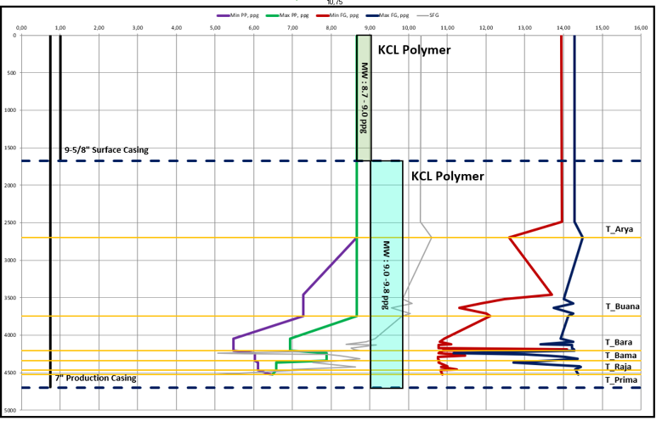
MUD SYSTEM SELECTION & MINIMUM RHEOLOGICAL PROPERTY REQUIREMENTS
Table 7.1 Alpha-07 Drilling Fluid Design Criteria
Table 7.2 Alpha-07 Minimum Rheological Property Requirements
Parameter | 12-¼ in. hole | 8-½ in. production hole
Mud System | KCl-Polymer WBM | KCl-Polymer WBM
Planned MW | 8.7–9.0 ppg | 9.0–9.8 ppg
Main Formation Behavior | Upper shallow formation and shale interval | Shale and deeper reservoir sandstone intervals
Main Mud Function | Shale inhibition, wellbore stability, and hole cleaning | Wellbore stability, pressure control, hole cleaning, and reservoir-section drilling
Main Drilling Risks | Reactive clay, gumbo and surface leaking | Reactive clay, Sloughing, loss circulation during drilling and/or cementing, stuck pipe, differential sticking, logging stop, and casing stop
MW Selection Basis | PP, wellbore stability, and applicable FG | PP, SFG, minimum applicable FG, and actual hole response
Parameter | 12-¼ in. hole | 8-½ in. production hole
Mud System | KCl-Polymer WBM | KCl-Polymer WBM
MW Range | 8.7–9.0 ppg | 9.0–9.8 ppg
PV | ALAP | ALAP
YP | 16–22 lb/100 ft² | 26–30 lb/100 ft²
KCl Concentration | 5% | 5%
LSRYP | Not Specified | 7 – 10
Max API Filtrate | 10 | 5
Max MBT | 12.5 | 12.5
Shaker Screen | 80–140 | 140–200
Figure 7.1 Alpha-07 Drilling Fluid and Mud Weight Program
KCL-Polymer Water Based Mud (WBM) for both 12-¼ and 8 ½ section.
Maintained PV As Low As Practicable (ALAP), Yield Point of that increasing effectively to lowest section, and KCL concentration at a minimum of 5%.

Slide 18
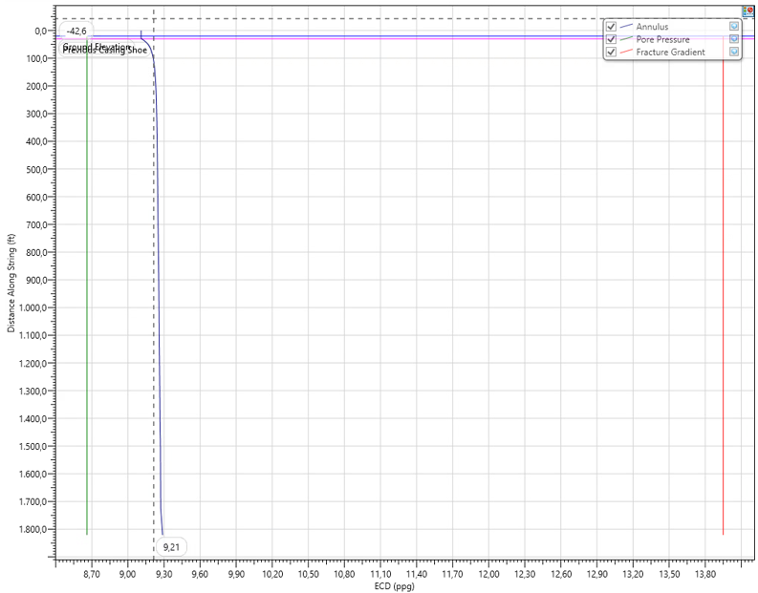
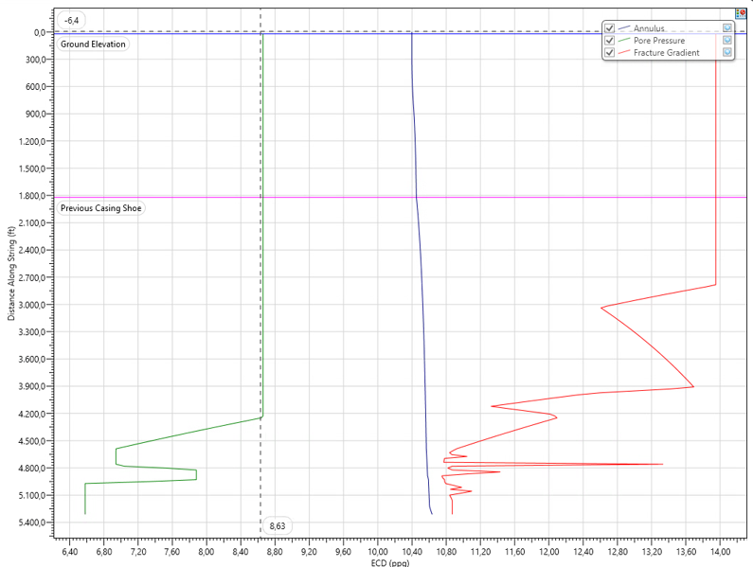
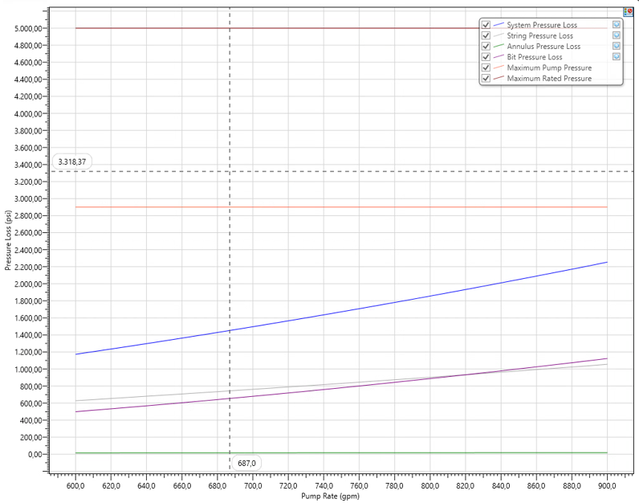
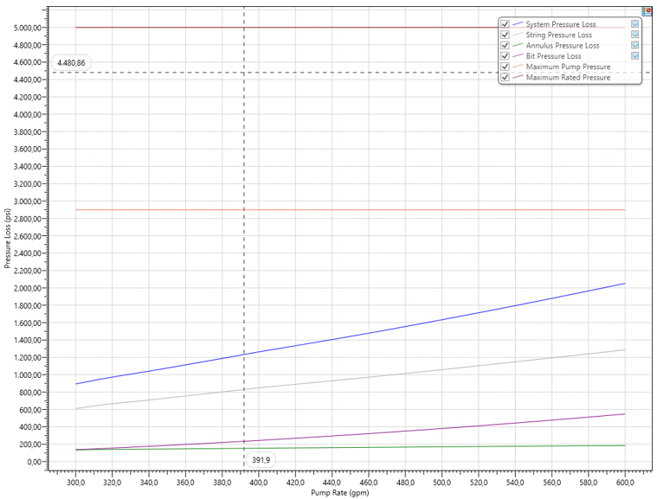
EQUIVALENT CIRCULATING DENSITY (ECD) LIMITS
Table 7.3 Alpha-07 ECD Design Criteria
Parameter | Design Criterion
Static MW | Within approved Alpha-07 MW window
ECD at Bit | Below applicable FG
ECD at Shoe / Weak Interval | Below applicable formation integrity limit
SPP | Within allowable surface equipment and BHA pressure limits
Operating Flow Rate | Within both ECD and SPP operating envelope
Annular Pressure Loss | Considered in ECD calculation
System Pressure Loss | Considered in SPP calculation
Hydraulic Monitoring | SPP, ECD, flow rate, MW and rheology
ECD versus Flow Rate 12-1/4” Hole
Max ECD is 9.29 ppg with Flow Rate 900 gpm
ECD versus Flow Rate 8-1/2” Hole
Max ECD is 10.64 ppg with Flow Rate 600 gpm
Design Criteria :
ECD Operating < FG Limiting
with adequate operations margin maintained for expected operation variations
SPP versus Flow Rate 12-1/4” Hole
Max SPP is 2254.89 psi with Flow Rate 900 gpm (Still below with Max PRV 6” Liner at 2900 psi)
SPP versus Flow Rate 8-1/2” Hole
Max SPP is 2052.43 psi with Flow Rate 600 gpm (Still below with Max PRV 6” Liner at 2900 psi)

Slide 19
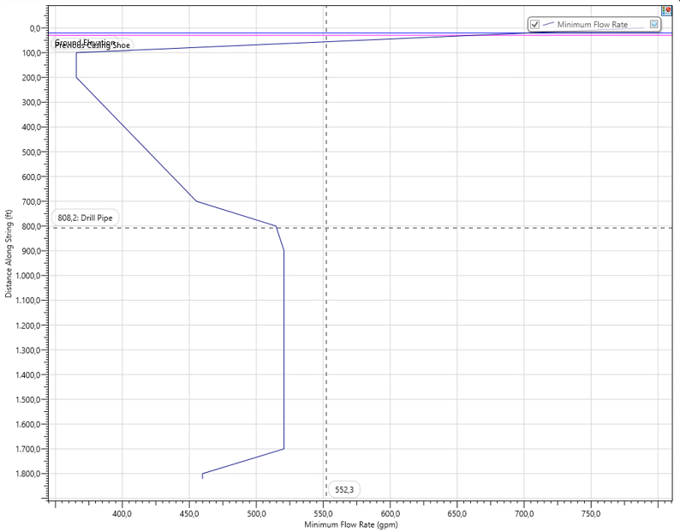
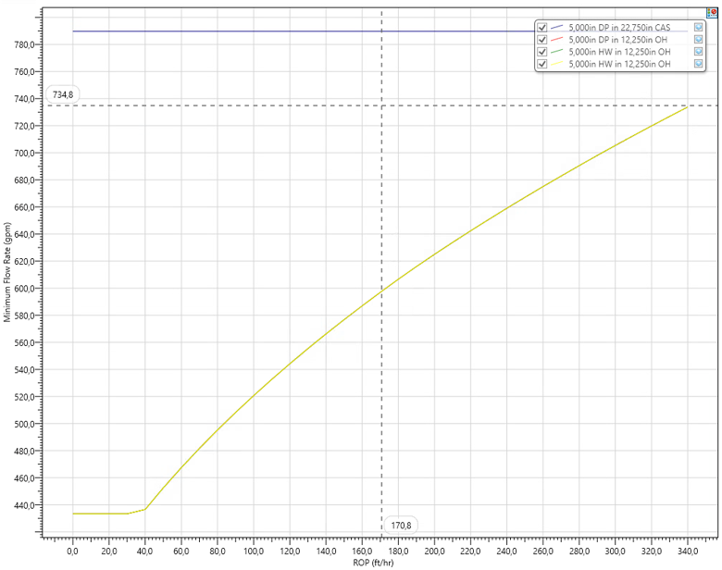
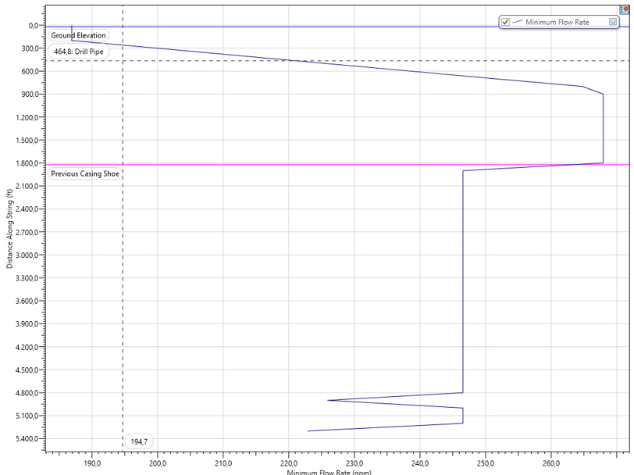
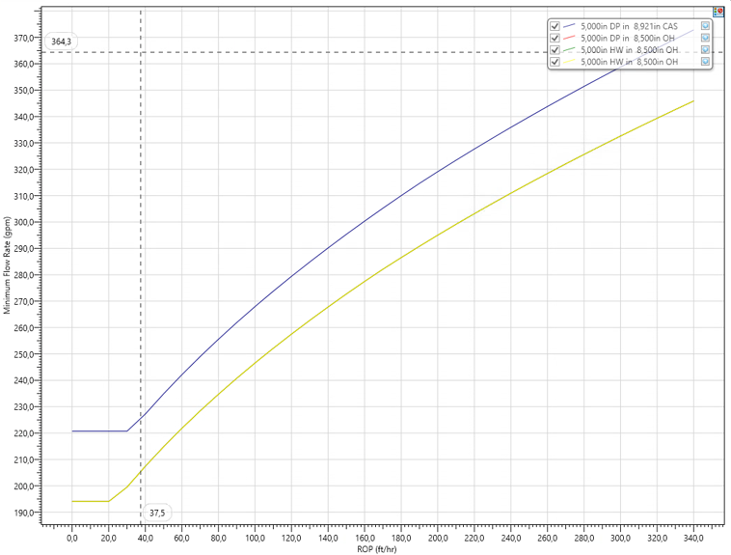
HOLE CLEANING REQUIREMENTS
Table 7.4 Alpha-07 Hole Cleaning Design Criteria
Parameter | 12-¼ in. hole | 8-½ in. production hole
Hole Size | 12-1/4 in. | 8-1/2 in.
Trajectory | Build + Tangent | Tangent
Maximum Inclination | ~30.41° | ~30.41°
MW | 8.7–9.0 ppg | 9.0–9.8 ppg
Cutting’s diameter | 0.190 | 0.250
Cutting’s density | 1.9 | 2.2
Design ROP | 100 | 100
RPM | 40 | 90
Minimum Flow Rate |  | 464. 3 gpm
Operating Flow Rate | > Minimum FR | > Minimum FR
Maximum Flow Rate | Limited by ECD / SPP / BHA | Limited by ECD / SPP / BHA
Minimum Flow Rate versus Depth 12-1/4 in. Hole
Minimum flow rate to clean out around 520.7 gpm with MW 9.0 ppg
Minimum Flow Rate versus ROP 12-1/4 in. Hole
Minimum flow rate to clean out around 520.7 gpm with ROP 100 fph
Design Criteria (hydraulic operating philosophy) :
FR Operating < FG Minimum Hole Cleaning
subject to :
ECD < FG Limiting
In case needs to increase ROP that causes exceeding flow rate, preferable to control rilling rate rather than increasing flow rate beyond ECD or SPP limit
Minimum Flow Rate versus Depth 8-1/2 in. Hole
Minimum flow rate to clean out around 267.9 gpm with MW 9.8 ppg
Minimum Flow Rate versus ROP 8-1/2 in. Hole
Minimum flow rate to clean out around 267.9 gpm with ROP 100 fph

Slide 20
BIT HYDRAULICS OPTIMIZATION
Table 7.5 Alpha-07 Bit Hydraulics Design Criteria
Parameter | 12-¼ in. hole | 8-½ in. production hole | Design Check
Operational Flow Rate | 900 gpm | 600 gpm | Above minimum hole-cleaning requirement
Bit TFA | 0.77 in2 | 0.77 in2 | Per selected bit/nozzle design
HSI | 5 hp/in2 | 3.4 hp/in2 | Adequate bit cleaning
Bit Nozzle Velocity | 374 ft/s | 250 ft/s | Adequate jet velocity
Bit Pressure Loss | 1123.35 psi | 547.89 psi | Within hydraulic allocation
SPP | 2254.89 psi | 2052.43 psi | Below system pressure limit
Pump Power | 1183.82 hp | 718.35 hp | Within pump capability
Bit Hydraulic Power | 589.76 hp | 191.76 hp | Adequate hydraulic energy
Power at Bit | 49.82% | 26.69% | Within optimized hydraulic distribution
Annular Pressure Loss | 18.14 psi | 185.29 psi | ECD impact acceptable
ECD at Shoe | 9.11 ppg | 10.45 ppg | Below applicable FG
ECD at Bit | 9.29 ppg | 10.64 ppg | Below applicable FG
Hydraulic simulation conducted using selected BHA, bit nozzle configuration, mud properties, and operating flow rate that optimize design while maintaining SPP and ECD within allowable operating envelope.
The results will provide sufficient jet energy to clean the bit face and remove cutting without release excessive pressure losses on the circulating system

Slide 21
WELL CONTROL, PRESSURE CONTROL & RIG CAPABILITY

Slide 22
WELL CONTROL, PRESSURE CONTROL
The design basis is to keep two verified independent well-barrier envelopes whenever a potential flow path from formation to surface exists.
Barrier philosophy
Primary: overbalanced mud column.
Secondary: casing + cement + wellhead + BOP + choke/kill system.
Monitoring: pit volume, flow rate/out, trip volume, gas indication and drilling parameters.
5M
well-control class
5,000 psi
minimum WP
10M
upgrade trigger if SIWHP > 5,000 psi
Fluid
primary barrier
Casing +
Cement
secondary
Wellhead
+ BOP
13-5/8 in. 5M
Choke /
Kill
5M lines

Slide 23
RIG SELECTION
The selected 750 HP land rig has sufficient hoisting, pumping and power capacity for the Alpha-07 drilling program.
Power
3 × 1,200 kW gensets
Capacity confirmation
570 HP
drawworks required
750 HP
selected rig
282k lbs
max derrick load
Top Drive
DQ40 | 250 ton | 0–180 rpm
Basis includes TD 5,312 ft MD, max overpull 100,000 lbs, block + TDS 30,000 lbs and 90% hoisting efficiency.
Circulation
3 in. mud path | 5,000 psi
3 × F-1000
mud pumps
5,000 psi
pump discharge
950 GPM
vacuum degasser
Operation
drill / ream / backream

Slide 24
COMPLETION, PRODUCTION & WELL ABANDONMENT

Slide 25



WELL COMPLETION & TESTING CRITERIA
KEY DESIGN PARAMETERS
Completion Design Requirements
Parameter | Alpha-07 Design Basis
Completion Type | Cased-Hole ESP Completion
Production Casing | 7 in.
Perforation Interval | ∼4,000–4,500 ft TVDSS (preliminary)
Production Tubing | 3-1/2 in., 9.3 ppf, J-55, EUE
Tubing ID / Drift | 2.992 in. / 2.867 in.
Reference MUT (Min/Opt/Max) | 1,710 / 2,280 / 2,850 ft-lbf
Packer | Not planned – packerless base case
Tubing Fill-Up (RIH) | KCl water every 10 joints
Cable Megger Check | Every 20 joints during RIH
Tubing Hanger Seal Test | 500 psi + MASP, 5 min
Cased-hole ESP completion; 7 in. production casing cemented across reservoir for zonal isolation
Selective perforation of approved intervals within ∼4,000–4,500 ft TVDSS preliminary window
Final gun size, shot density, phasing & firing sequence set after formation evaluation
Production Tubing & Accessories (Packer, SSSV)
3-1/2 in., 9.3 ppf, J-55 EUE tubing — 2.992 in. ID / 2.867 in. drift; packerless ESP base case
Cable protector per joint; bands & check/bleeder valve above ESP; KCl fill-up every 10 joints RIH
ESP cable megger/integrity check every 20 tubing joints during RIH
Well Testing / Handover
No swabbing or production well testing within Drilling & Initial Completion (IC) scope
IC executed by drilling rig, including perforation and ESP string installation
Handover to Production/Operations after tubing hanger seal test (500 psi + MASP, 5 min)

Slide 26



WELL SUSPENSION & ABANDONMENT (P&A) CRITERIA
KEY ABANDONMENT PARAMETERS
a. Final Zonal Isolation (Cement Plugs)
Parameter | Alpha-07 Design Basis
Reservoir / Perforation Isolation | Min. 100 ft above & below perforated interval
Open-Hole Formation Isolation | Min. 100 ft below to 100 ft above formation
Open Hole Below Casing Shoe | Min. 100 ft below to 100 ft above shoe
Surface Cement Plug | Minimum 150 ft
Mechanical Plug Verification | Min. 15,000-lbf load test
Cement Plug Pressure Verification | Min. 1,000 psi for 15 min
Casing / Wellhead Cut-Off | Min. 3 ft below ground level (onshore)
Surface Equipment | Removed per approved ASR plan
Re-greening / Revegetation | Required as applicable
Final Site Condition | Subject to regulatory & stakeholder acceptance
Perforated interval: plug min. 100 ft above/below interval, or to nearest applicable plug
Open-hole & casing-shoe zones: min. 100 ft below–above formation/shoe
Surface cement plug of min. 150 ft, top located ∼150 ft below surface/mud-line reference
b. Barrier Verification
Verified by minimum 15,000-lbf load test on cement retainer/bridge plug, or
Minimum 1,000-psi pressure test for 15 minutes, per reference ASR requirement
Field reference basis: Plugs 1–3 verified by 15,000-lbf tag & 1,000-psi test
c. Surface Restoration Requirements
Wellhead, casing & obstructions removed to min. 3 ft below ground level (onshore)
Above-ground facilities (fencing, piping, installations) removed per approved ASR plan
Site re-grading and re-greening/revegetation as applicable

Slide 27
WELLSITE & EXECUTION STRATEGY

Slide 28

WELL SITE PREPARATION
2 – 2.5 ha
750 HP
24 in.
6 days
Wellpad + supporting facilities
Land rig design basis
Pre-set conductor
Short-move rig mobilization & rig-up
Wellpad & Ground
Cellar & Conductor
Access Road & Bridge
• New wellpad for rig, drilling equipment and heavy-equipment movement
• Civil/geotechnical assessment → bearing capacity & ground improvement
• Soft ground / heavy rain: compaction, suitable fill or matting as required
• Cellar completed before rig mobilization; drainage required
• 24 in. × 1-joint pre-set conductor
• Driven with 2-ton drop hammer; acceptance based on approved BPF criterion
• Route survey before rig move
• Verify road/bridge load capacity & clearance for 750 HP rig
• Strengthening/matting, permits and traffic control where required
Water Supply & Storage
Waste & Environmental Control
Sources: GS standpipe / CMTF / available field canal
Water quality check is required before mud preparation and must be compatible with KCI-Polymer WBM
Maintain adequate storage buffer; approved alternative source may be used as contingency
• Dedicated disposal pit with geomembrane + containment berm
• Liquid drilling waste → temporary pit → vacuum truck → CMTF
• Chemical & domestic waste segregated at source; prevent soil/water contamination

Slide 29
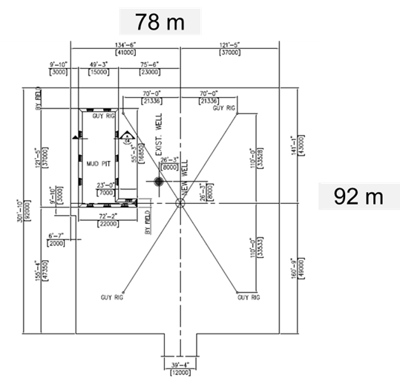
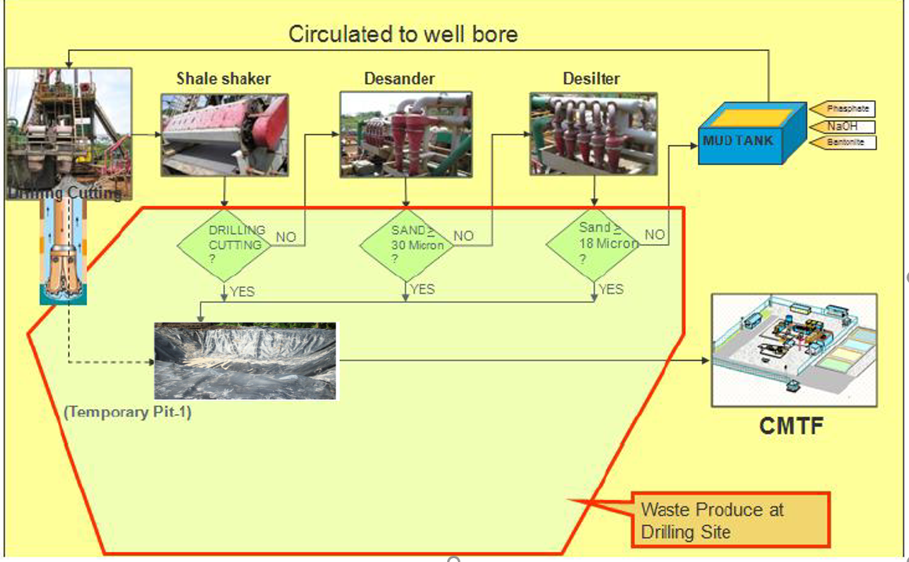
WELL SITE PREPARATION
Figure 13.2 Alpha-07 Drilling Waste Handling & Disposal
Figure 13.1 Typical 750 HP Rig Wellpad Layout for Alpha-07

Slide 30
EXECUTION STRATEGY / GENERAL OPERATIONAL SEQUENCE
Short moving (Intra Field) → Total Well Cycle Including Moving (Moving + drilling + initial completion) → 21.30 days
1
2
3
4
5
6
7
Move-in & Rig-up
Rig mobilization, positioning, rig-up and preparation of drilling equipment
Preparation
Final wellsite/rig readiness, pre-spud preparation, conductor and drilling preparation activities
Drill Surface: 12-1/4 in.
Drill 12-1/4 in. hole to planned surface casing depth
Flat Time: 9-5/8 in. casing
CHC, POOH/L/D BHA, RIH 9-5/8 in. casing, cementing, wellhead installation, N/U BOP, S/U string and drill-out preparation
Drill Production
8-1/2 in.
Drill 8-1/2 in. directional hole to planned production TD
Flat Time:
Logging + 7 in.
Final CHC, POOH/L/D BHA, OH logging, RIH 7 in. casing, cementing, WOC, N/D BOP and final wellhead installation
Initial
Completion
CBL, perforation, RIH production tubing and ESP completion
6.00 days
0.43 days
1.30 days
2.94 days
2.95 days
5.76 days
1.92 days
Operational Sequence — Key Activities
Execution Targets & Control
Surface section (~1,800 ft MD): drill 12-1/4 in. hole → 9-5/8 in. casing → cement → wellhead/BOP preparation.
Production section (~5,000 ft MD): directional drilling 8-1/2 in. hole → OH logging → 7 in. casing → cement/WOC → final wellhead installation.
Initial completion: CBL → perforation → 3-1/2 in. production tubing + ESP
Drilling, casing, logging + Initial Completion: 15.30 days (excluding moving rig)
Total well cycle, Short Move: 21.30 days (6 days for rig moving + rig-up)
Long Move / Inter-field: 29.30 days (14 days long moving & rig-up + 15.30 days drilling & completion)
Actual Days vs Depth (DVD) is tracked against the planned benchmark to identify deviation and enable timely improvement
Strategi Utama: Site readiness → Safe rig mobilization → Controlled drilling → Logging/Casing → ESP Completion

Slide 31
RISK, SCHEDULE, COST & PROJECT ASSURANCE

Slide 32
TECHNICAL RISK MANAGEMENT
Risk register → preventive design → real-time surveillance → contingency response
Priority Technical Risk Register
Risk Management Logic
Risk
Exposure / Impact
Level
Primary mitigation
1
Prevent
2
Monitor
3
Trigger
4
Respond
Reactive clay / gumbo
Balling, low ROP, poor hole cleaning
M
KCl-polymer inhibition; maintain mud properties; monitor cuttings
Design + modeling
→
RT drilling surveillance
→
Deviation / early warning
→
Contingency action
Sloughing / instability
Cavings, pack-off, drag / overpull
M
MW vs. depth basis; cavings monitoring; inhibition + hole cleaning
Tight hole / drag
Difficult trips; casing / logging restriction
Track P/U, S/O & rotating weight vs. T&D baseline; condition hole
Key Control Envelope
M
Loss circulation – drilling
Partial/total losses; reduced hydrostatic
H
Control ECD; HiVis sweeps; preventive LCM/fiber; loss contingency
8.7–9.0
9.0–9.8
10.75
Loss circulation – cementing
Poor placement / zonal isolation
Manage placement ECD; LCM/fiber; lightweight cement; top-job contingency
Surface MW (ppg)
Production MW (ppg)
Lowest SFG / FG basis (ppg)
H
Differential sticking
Stuck pipe, fishing, NPT
H
Fluid-loss control; bridging material; minimize static exposure; monitor ECD/T&D
33.8
10
5M
Logging stop / stuck tool
Incomplete evaluation; extra trip / NPT
M
Final hole conditioning; conditioning trip; alternative conveyance ready
Kick tolerance @ 0 KI (bbl)
Minimum KT requirement (bbl)
BOP pressure class
Casing stop
Cannot reach planned casing depth
M
Condition hole; verify hole condition; casing-running contingency

Slide 33
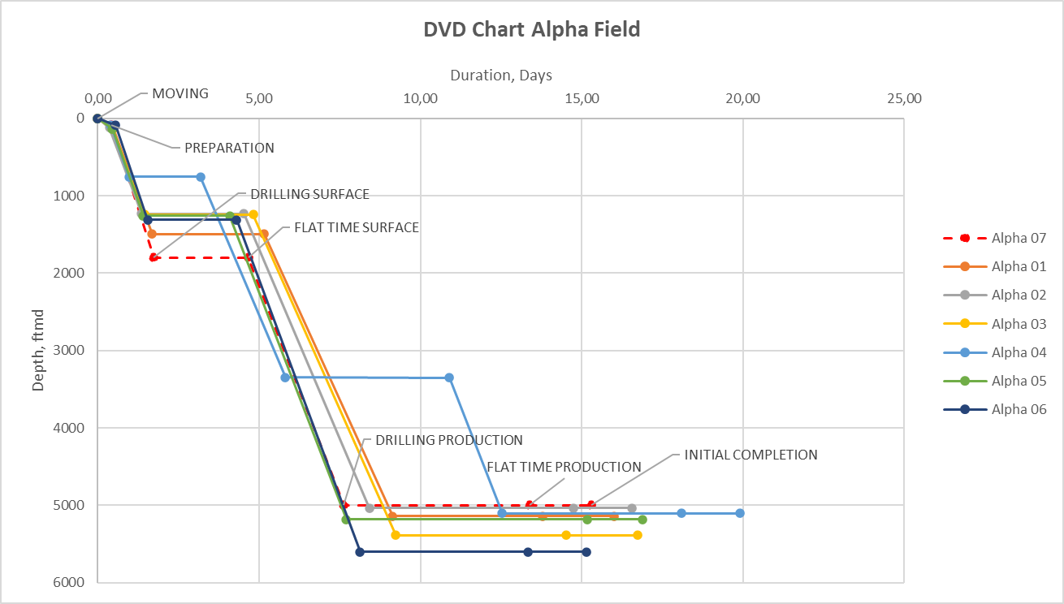
SCHEDULE, COST & PROJECT ASSURANCE
Schedule, Cost & Project Assurance
15.30 d
21.30 d
29.30 d
Integrated view of well delivery time, depth benchmark, cost exposure and approval gates
Drilling + Initial Completion
Total cycle — Short Move
Total cycle — Long Move
Days vs Depth — Alpha-07 benchmarked to Alpha-01…06
USD 1.78M
USD 1.97M
Q4 2026
Short Move Case
Long Move case
Target spud
Conceptual Cost Split
Tangible 23.7%
Intangible 76.3%
USD 422k
USD 1.358M
Tangible
Intangible
10%
Maximum cost overrun in success criteria
BOD Approval & Assurance Workflow
Drilling
›
Subsurface
›
Facilities / HSE
›
Project Integration
›
Asset approval

Slide 34
JDS 2026 DRILLING CAMPAIGN
SW (Single Well) DPM (Drilling Project Management) BOD: ALPHA-07
CORE ENERGY SOLUTION
GROUP 6 ONLINE

Slide 35
Table 3.3 Alpha-07 Offset Well Subsurface Design Basis
Design Aspect | Offset Well Observation | Application to Alpha-07
Stratigraphy | Equivalent upper shale and deeper sandstone sequences penetrated | Used for geological prognosis
Wellbore Stability / SFG | Historical shale instability, sloughing, and wellbore condition from offset wells | Used to support Shear Failure Gradient assessment and minimum mud weight design
Loss Circulation | Potential losses within deeper sandstone intervals | LCM and loss contingency required
Shallow Gas | Low TG and no significant historical gas indication | Supports current well construction concept
Reservoir Pressure | Offset pressure information available | Used for PP prediction
Formation Integrity / FG | Historical formation integrity and loss-circulation behavior from offset wells | Used to support Fracture Gradient assessment and maximum allowable ECD / pressure design
Logging | Triple Combo, RFT and SWC established as evaluation basis | Applied to Alpha-07 formation evaluation
Reservoir Fluids | Predominantly oil with localized gas indication | Incorporated into well control and completion design

Slide 36
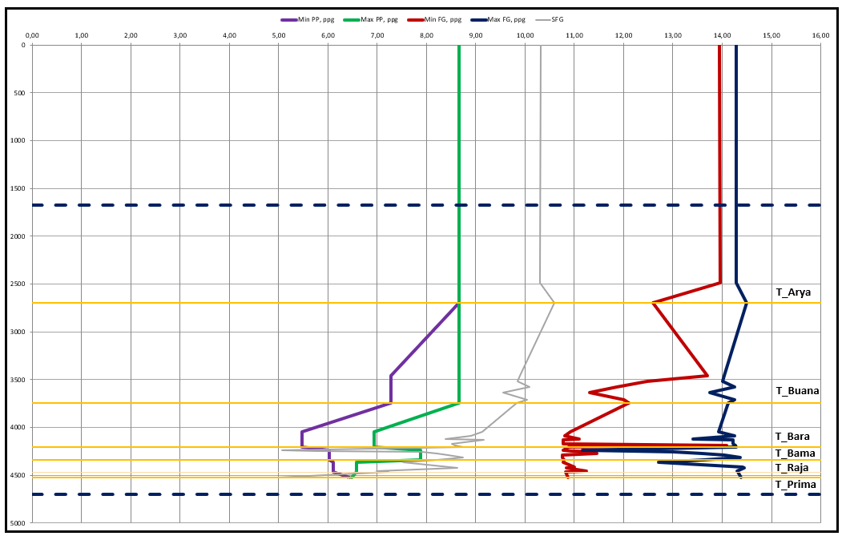
SUPPORTING SLIDES
Parameter | Preliminary Design Basis
Maximum Estimated Pore Pressure | 8.66 ppg EMW
Lowest Estimated Sand Fracture Gradient | ~10.75 ppg EMW
Surface Section Mud Weight | 8.7–9.0 ppg
Production Section Mud Weight | 9.0–9.8 ppg
Pressure Prediction Basis | Formation pressure data + Eaton model
FG/SFG Calibration Basis | Historical drilling data
Final Design Requirement | Maintain adequate overbalance while remaining below formation integrity limit
Preliminary Alpha-07 PPFG Design Basis
Alpha-07 Predicted Pore Pressure and Fracture Gradient Profile

Slide 37
SUPPORTING SLIDES
Casing Seat & PPFG Design Basis
Kick Tolerance Calculation Basis
Parameter | 9-5/8 in. Surface Casing | 7 in. Production Casing
Hole Size | 12-1/4 in. | 8-1/2 in.
Setting Depth, MD | 1,821 ft | 5,312 ft
Setting Depth, TVD | 1,654 ft | 4,664 ft
Planned Mud Weight | 8.7–9.0 ppg | 9.0–9.8 ppg
Seat Criterion | Competent shale 1,550–1,650 ftTVDSS | Below deepest target + rat hole
Kick Tolerance | ≥10 bbl for 8-1/2 in. hole | N/A – final string
Parameter | Design Basis
Critical Casing Shoe | 9-5/8 in. Surface Casing
Shoe Depth | 1,821 ftMD / 1,654 ftTVD
Subsequent Hole Size | 8-1/2 in.
Section TD | 5,312 ftMD / 4,664 ftTVD
Maximum Planned MW | 9.8 ppg
LOT / Formation Integrity | 14.4 ppg
Minimum KT Requirement | 10 bbl / 1.5 m³
Kick Intensity Design Range | 0–0.5 ppg
Calculated KT @ 0 ppg KI | 33.8 bbl
PPFG Envelope: max estimated pore pressure 8.66 ppg EMW; lowest sand fracture gradient ≈10.75 ppg EMW — this bounds the mud weight and ECD design window.
Casing Structural Load Cases & Preliminary Design Summary
Design Mode | Min. DF | Applicable Load Cases | Design Consideration
Burst | 1.10 | Gas kick, pressure test, tubing leak | Internal pressure < burst resistance
Collapse | 1.10 | Cementing, partial evacuation | External ΔP < collapse resistance
Axial | 1.25 | RIH, self-weight, margin overpull | Within body & connection capacity
Triaxial | 1.25 | Combined pressure + axial | Within casing strength envelope
Casing | Burst SF | Collapse SF | Axial SF | Triaxial SF | Assessment
9-5/8 in., 36 ppf, K55 | 3.52 | 2.88 | 1.91 | 1.90 | Meets criteria
7 in., 23 ppf, K55 | 2.18 | 1.47 | 1.42 | 1.41 | Meets criteria
Minimum Required | 1.10 | 1.10 | 1.25 | 1.25 | —
Governing Case: the 7 in. production casing collapse SF (1.47) and triaxial SF (1.41) are the lowest margins in the design; both remain above the required 1.10 and 1.25 respectively. Production casing load cases additionally include the completed-well tubing-leak scenario, which the surface casing does not carry.

Slide 38
SUPPORTING SLIDES
Full Cement Slurry Property Limits
Reference Laboratory Performance & Placement Parameters
Parameter | 12-1/4" Lead | 12-1/4" Tail | 8-1/2" Lead | 8-1/2" Tail
Cement Type | Class G | Class G | Class G | Class G
Density | ≥12.5 ppg | 15.8 ppg | ≥12.5 ppg | 15.8 ppg
Excess over theo. | 150% | 150% | 200% | 40%
Free Water | 0% | 0% | 0% | 0%
Thick. Time (70BC) | <4 hrs | <4 hrs | <6 hrs | <4 hrs
Comp. Strength (UCA) | 600 psi ≤17h | 1500 psi ≤7h | 600 psi ≤20h | 1000 psi ≤8h
24-hr Crush | ≥600 psi | ≥1,750 psi | ≥600 psi | ≥2,000 psi
Fluid Loss | <300 cc | <100 cc | <150 cc | <100 cc
BHCT / BHST | 122 °F | 122 °F | 198 °F | 198 °F
9-5/8 in. Application (12.5 ppg lead): 0% free water; 70-BC thickening time ≈3 hr 34 min; ≈500 psi compressive strength reached at ≈16 hr 18 min under the applicable laboratory conditions.
7 in. Application: 12.5 ppg lead achieved ≈4 hr 25 min thickening time and the 15.8 ppg tail ≈4 hr 30 min, both with zero free water.
Status of these values: reference performance only — not final Alpha-07 acceptance values. Final slurry must be laboratory tested with Alpha-07 BHCT/BHST, actual mix water and expected job duration.
Placement Sequence: condition hole ≥2 hole volumes → 40 bbl 11.0 ppg scavenger @ 4 bpm → 12.5 ppg lead → 15.8 ppg tail → release top plug → displace with 8.4 ppg brine, reducing rate at the end → bump plug at ≈500 psi above final circulating pressure.
Shoe Track: minimum ≈1.5% of total displacement volume retained to limit cement contamination below the float collar.
Connection Selection Rationale
Reassessment Triggers & Abandonment Interface
BTC – both casing strings: the buttress thread profile provides improved axial-load capacity compared with conventional round-thread connections, suiting casing running and subsequent drilling loads.
EUE – 3-1/2 in. production tubing: the external upset gives a larger connection cross-section than the tubing body, providing tensile capacity and reliable make-up for the ESP string, tubing hanger, check valve and bleeder valve.
No premium connection required: moderate maximum inclination (≈30.41°, J-type) and the absence of significant gas exposure do not trigger a gas-tight premium requirement under the current design basis.
Revisit connection selection if: higher pressure/temperature conditions arise; significant gas exposure requires enhanced gas-tight sealing; severe combined axial and pressure loading develops; or trajectory severity / wellbore tortuosity increases.
Any change from BTC or EUE must be supported by mechanical load verification and compatibility assessment with the associated casing, tubing, wellhead and completion equipment.
Abandonment Interface: the cement sheath forms part of the future well barrier system; permanent abandonment requires ≥100 ft of cement above and below the perforated interval, verified by 15,000-lbf tag or 1,000-psi test for 15 minutes.

